Slide 1
Final Project Data Analysis
MAT219 Rachel Johnston

Slide 2
About the show
Started 2005, ended 2013
9 seasons, 201 episodes total
Mockumentary comedy show about employees of Dunder-Mifflin Paper Company in Scranton, PA
Known for its…
Dry humor
Beloved characters
Funny and heartwarming moments

Slide 3
Purpose
Understand the social factors that contribute to the show’s popularity
Comedy line distribution between characters
Insight on certain episodes/seasons being more/less popular than others
Date (Season)
Characters
Plot line

Slide 4
About the Data
Office Tally website: All-Time Fan Favorite Poll
Fans vote for their favorite episode
12,000 votes
Conducted in 2011 (until season 7)
Web-scrape
Kaggle (DS platform that contains a variety of datasets)
”The Office Dataset” by Neha Prabhavaklar
“The Office Lines” by Fabrizio Cominetti

Slide 5
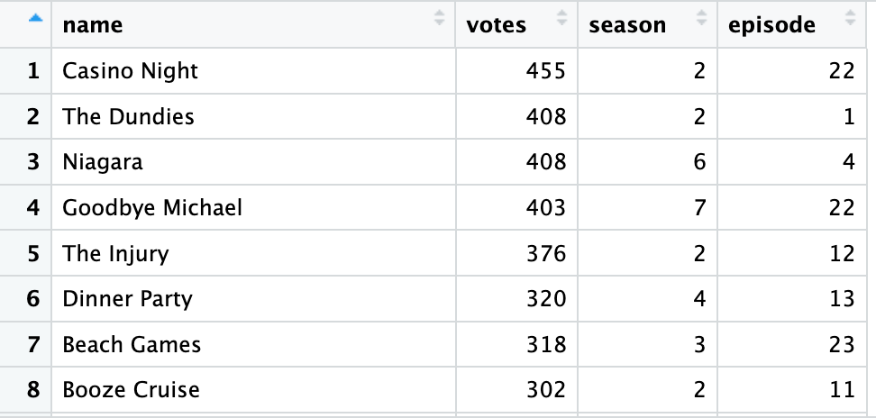
Web Scraping
Used read_html() from httr
Scraped the list and put it into a tibble
Made columns for episode title, number of votes, season, episode number
Used stringr function such as:
str_extract_all()
str_split()
https://www.officetally.com/the-office-all-time-fan-favorite-poll-2011

Slide 6
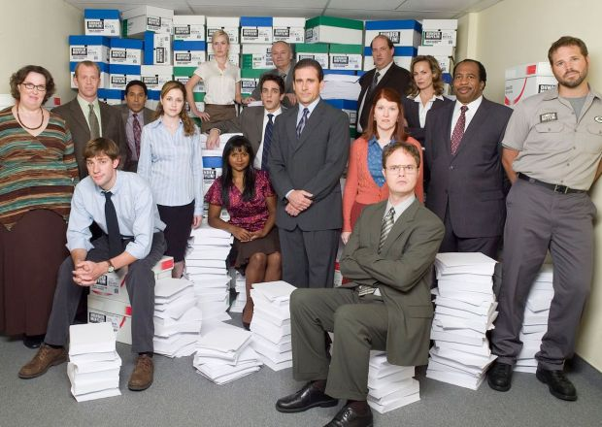
Datasets
CSV Files
read_csv()
Narrowed down “The Office Line” dataset
Used filter() to only include the following characters
Not included in picture:
Andy
Erin
Holly
Darryl
David
Pete
Clark
Gabe
Karen

Slide 7
Overview of the Data
“The Office Dataset”
Season
Episode title
About
Ratings
Votes
Viewership
Duration
Date
“The Office Lines” dataset
Character
Line
Season
Episode number
Episode title
All-Time Fan Favorite Poll
Episode title
Votes
Season
Episode number

Slide 8
Data Analysis/Visualization
The pretty and fun stuff!

Slide 9
Questions to answer
What is the most popular ”The Office” season?
Are there viewership and rating correlations to popularity?
Does the date that an episode is aired have a relationship with viewership and ratings?
What are the top 10 most popular episodes?
Top 10 most viewed episodes vs. top 10 best-rated
Do these line up with the Office Tally poll?
What is the percentage of comedy lines for each character?

Slide 10
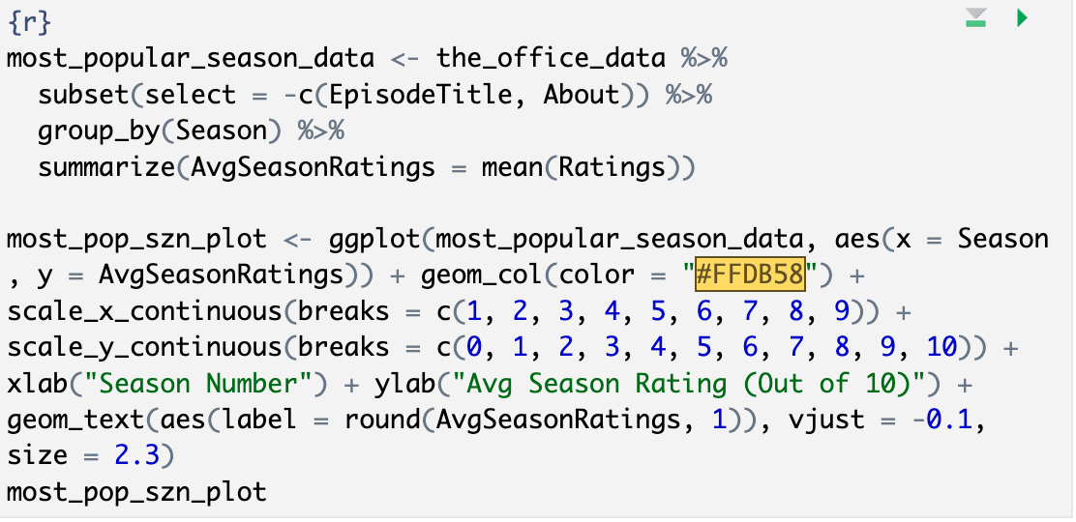
What is the most popular ”The Office” season?
Used “The Office Dataset”
Based on ratings (Out of 10)
Grouped the data by season, and summarize() to compute the average rating for each
Bar chart

Slide 11
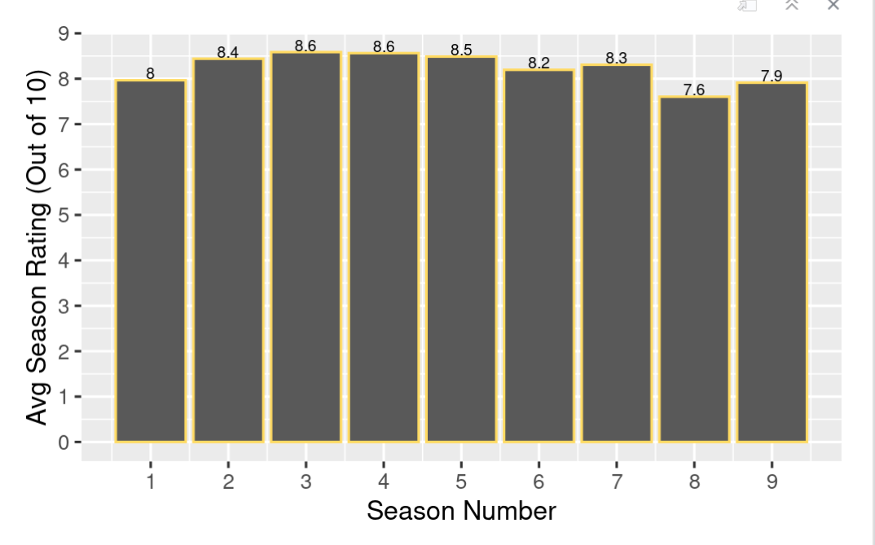
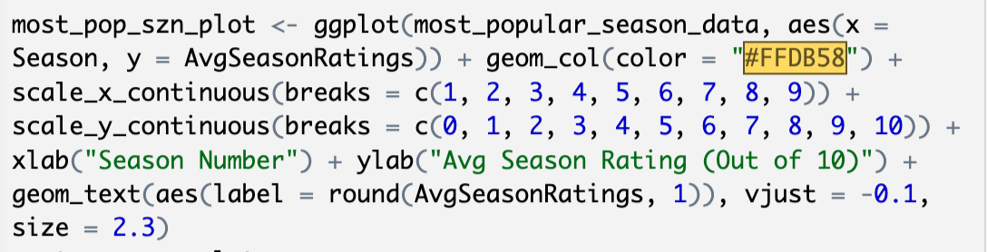
Seasons 3 and 4 have best ratings: 8.6
First two seasons helped fandom build
Season 8 has worst rating: 7.6
Michael Scott left the show in the finale of season 7
Viewers missed him!

Slide 12
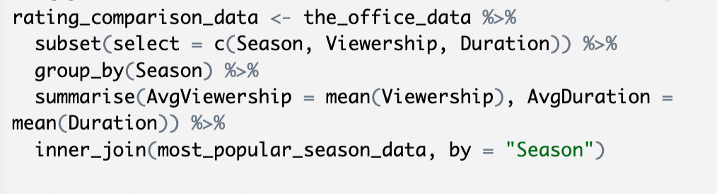
Are there viewership and duration correlations to ratings?
Used same dataset as previous
Viewership and duration variables
More views = more popular
Is there a preference for episode length? (Is there a preference at all?)
Grouped the data by season, and summarize() to compute the average viewership and duration for each
Scatterplot

Slide 13
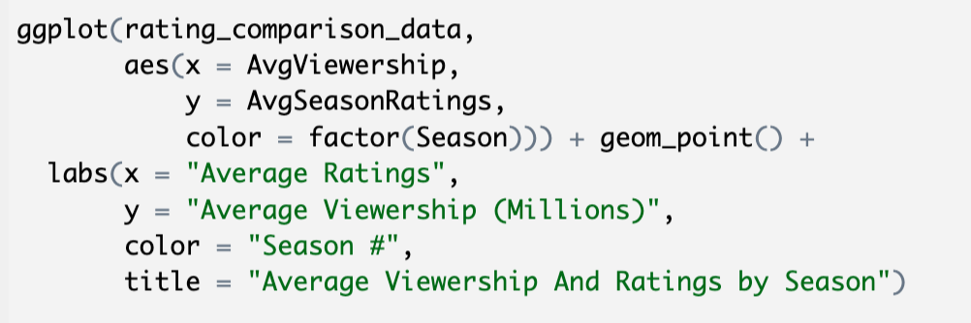
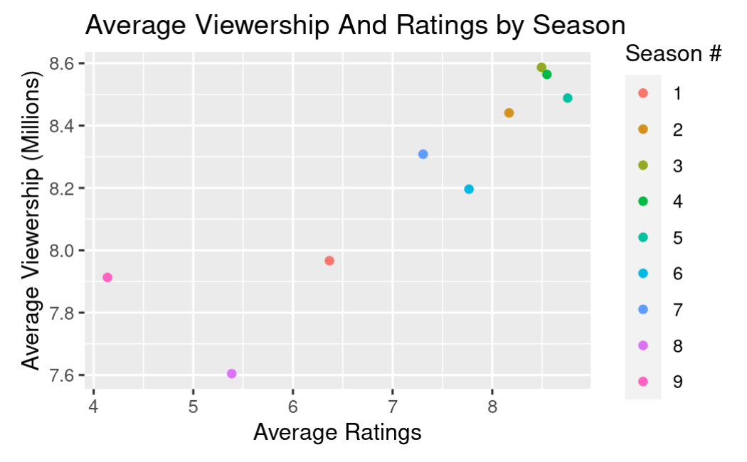
There is a positive relationship between viewership and ratings!
Can assume that increased viewership will most likely lead to higher ratings

Slide 14
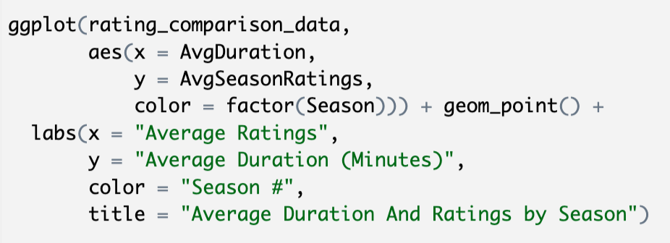
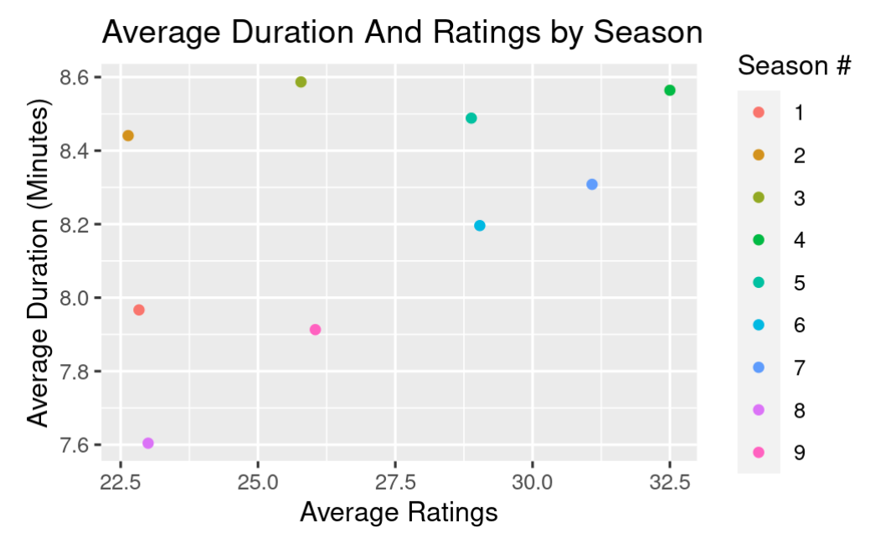
No trends displayed
Points do not have a pattern to them
Duration does not have a correlation with ratings!
Audience shows no preference for length of episodes

Slide 15
Does the date that an episode is aired have a relationship with viewership and ratings?
Same dataset: “The Office Dataset”
Sometimes seasonal episodes are the reason why viewers tune in!
Looked at months with popular holidays*
January: New Years
February: Valentines
October: Halloween
November: Thanksgiving
December: Christmas/Hanukkah/New Years Eve
*”The Office” did not air in June, July, or August

Slide 16
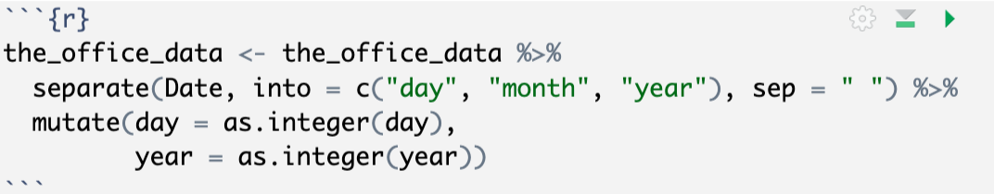
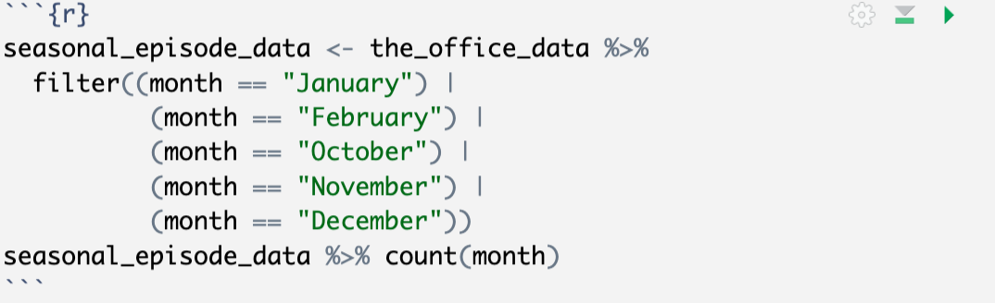
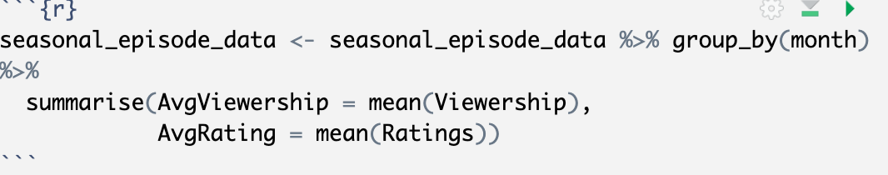
Split the date column into separate day, month, and year columns
Used filter() to narrow data down to the desired months
Used summarize() to calculate/display average viewership and ratings
*”The Office” did not air in June, July, or August

Slide 17
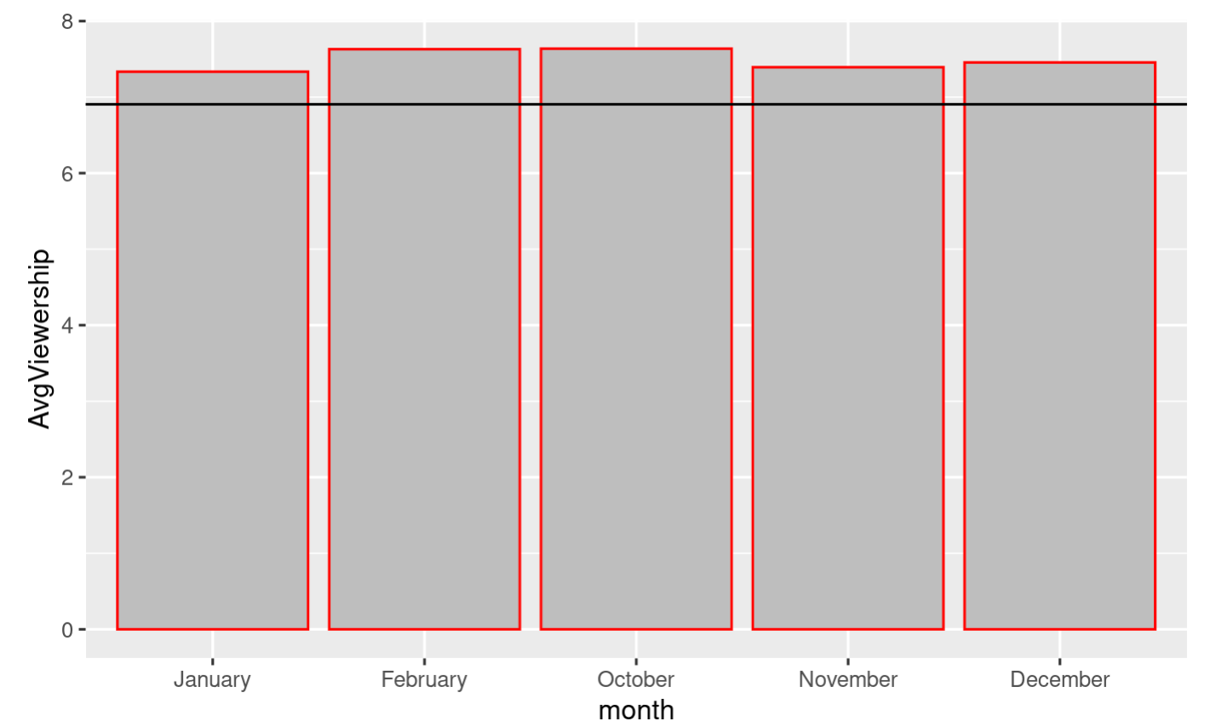
Viewership increases for seasonal episodes/months!
February and October are the highest
Viewers must like Valentine’s day and Halloween specials
Surprised that December wasn’t as increased as Feb. and Oct.!

Slide 18
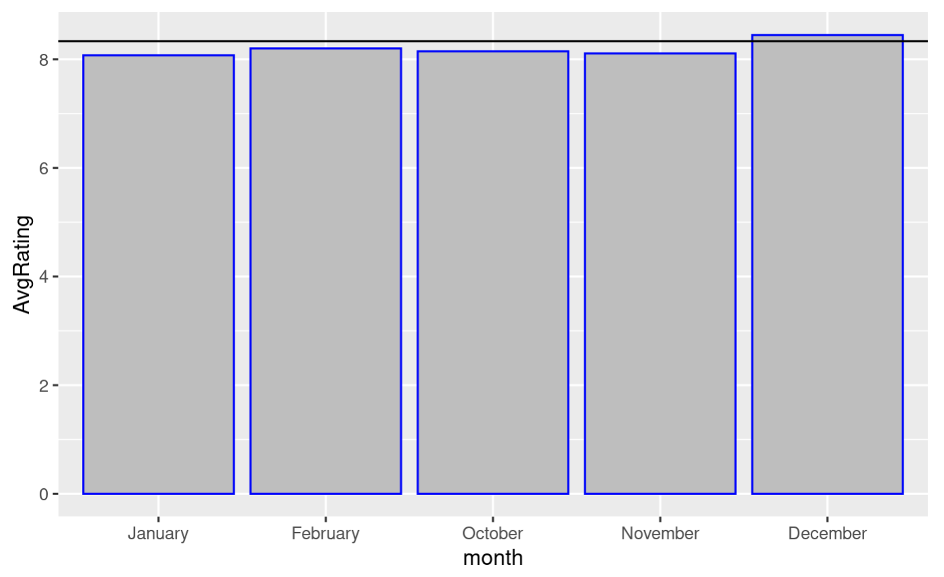
No increases except for December
Fans may tend to rate December/Christmas episodes a little higher than other
Soft spot for Chistmas?

Slide 19
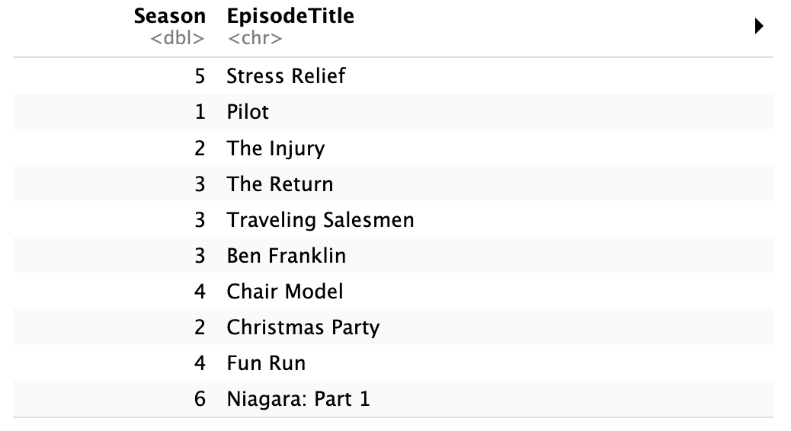
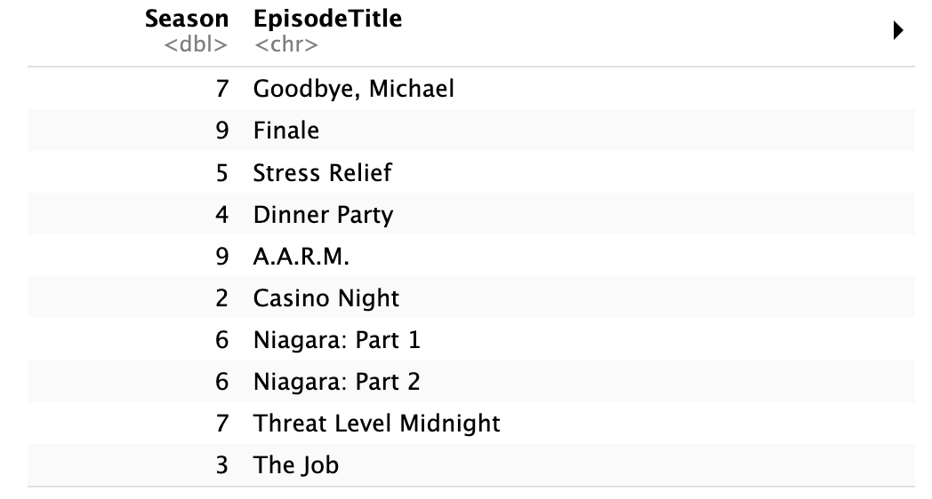
What are the top 10 most popular episodes?
Do the top 10 episodes from the Office Tally Poll line up with the data in “The Office Dataset”?
Limitation: The Office Tally poll was conducted in 2011, therefore it only had voting options up to the end of season 7
Pull top 10 most viewed and top 10 best-rated from dataset

Slide 20
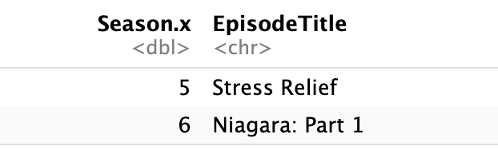
What are the top 10 most viewed episodes?
To see what the two lists have in common: inner_join()
”Stress Relief”: 1st in viewership, 3rd in rating
”Niagara: Part 1”: 10th in viewership, 7th in rating
Majority of episodes in the lists were different
“Good Bye, Michael” 1st in ratings
“Pilot” 2nd in viewership

Slide 21
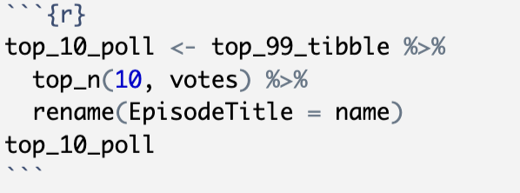
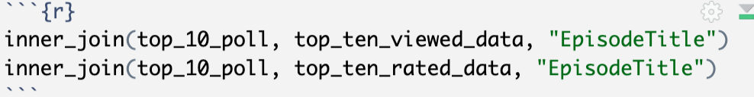
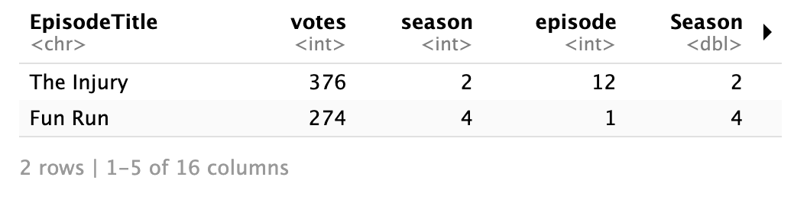
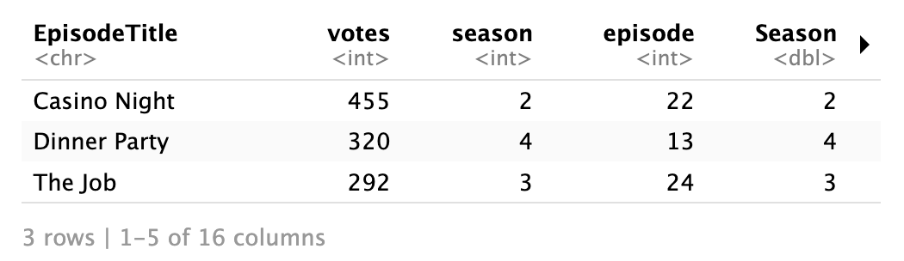
What are the top 10 most viewed episodes?
Top 10 episodes from the Office Tally
User inner_join() for both previous lists to see similarities
Inner join with most viewed
Inner join with best-rated

Slide 22
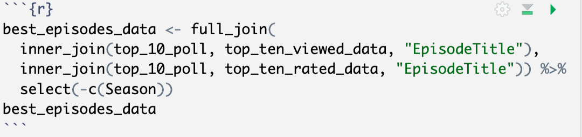
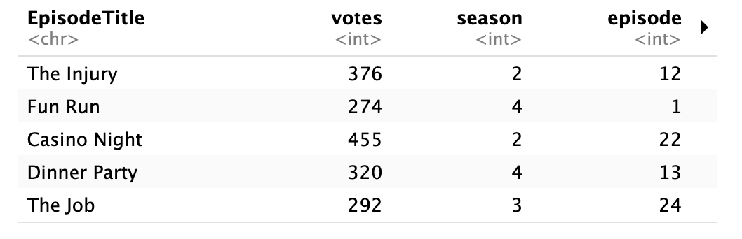
What are the top 10 most viewed episodes?
Determined that the 5 episodes that were inner-joined with the Office Tally poll as the most popular episodes of ”The Office”
Balances viewership, ratings, poll results
Used full_join() to combine them into a tibble

Slide 23
What is the percentage of comedy lines for each character?
“The Office Lines” dataset has a detailed list of comedy lines said by every character
Examine the ratio of comedy lines said between characters
Are some characters more prevalent to the comedy/plotline of the show than others?
Pie chart

Slide 24
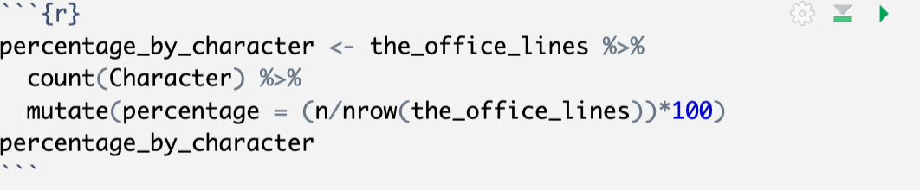
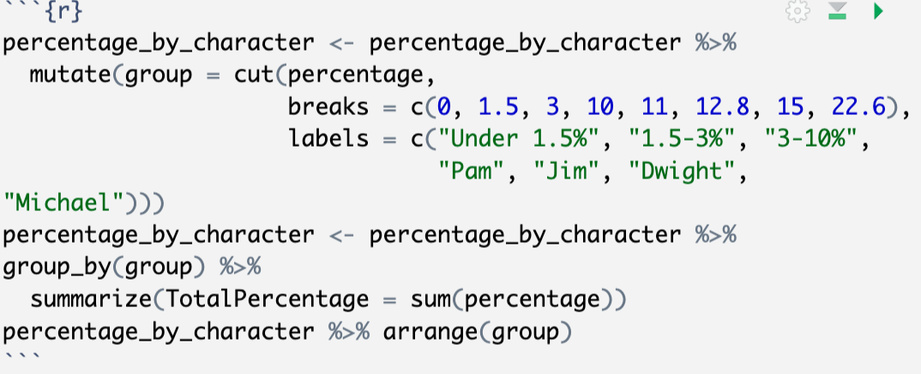
What is the percentage of comedy lines for each character?
Calculate the percentage of comedy lines said by each character
Realized the percentages are VERY small for each character
Divided into groups by percentage
1.5% and under
1.5-3%
3-10%
Characters with over 10% had their
own section

Slide 25
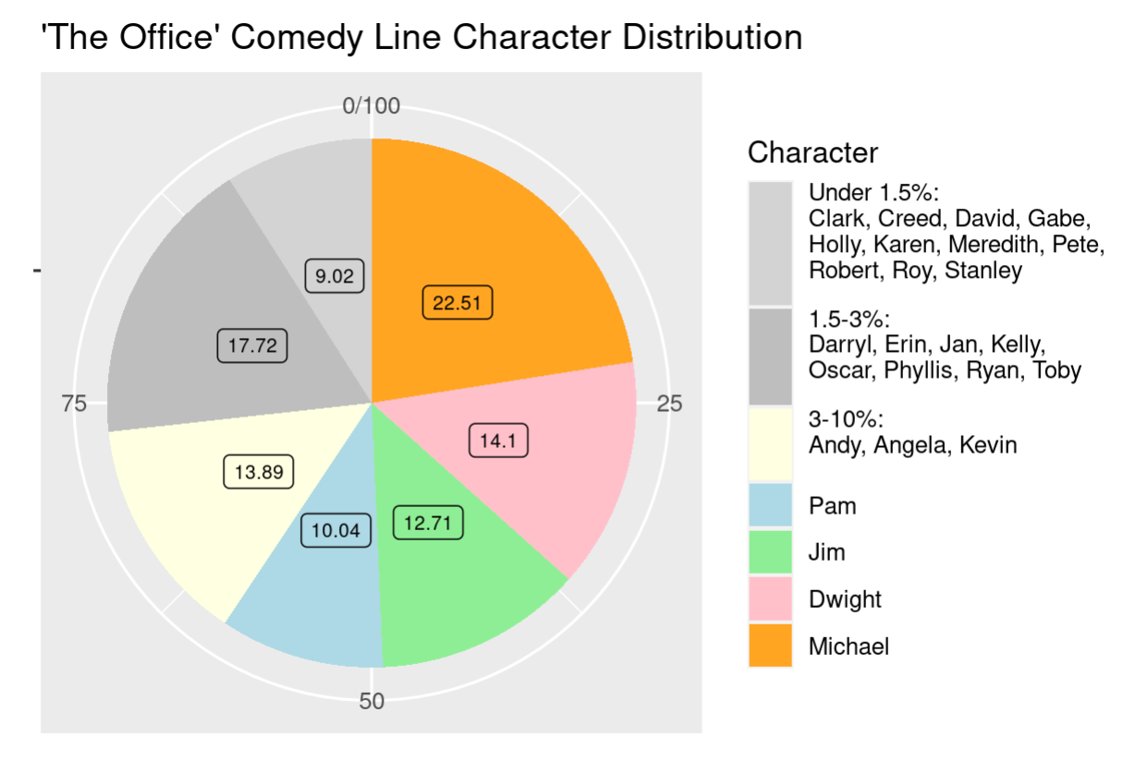
What is the percentage of comedy lines for each character?
Jim, Dwight, Pam, and Michael said over half the comedy lines! (about 59%)
Contribute most to the comedy and plot line of the show
Other characters said less than 10%

Slide 26
Conclusions
Season 3 and 4 are the most popular seasons
After season 7, viewers did not rate the show as highly
More viewers = higher ratings
Fans don’t have a preference of episode length
February (Valentines) and October (Halloween) episodes have increased viewership
December(Christmas/New Years) episodes have higher ratings

Slide 27
Conclusions
Top 5 episodes of ”The Office” are…

Slide 28
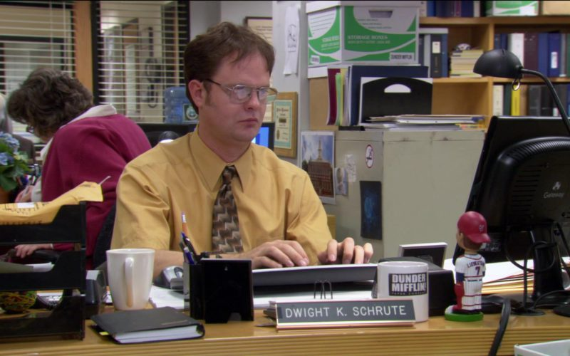
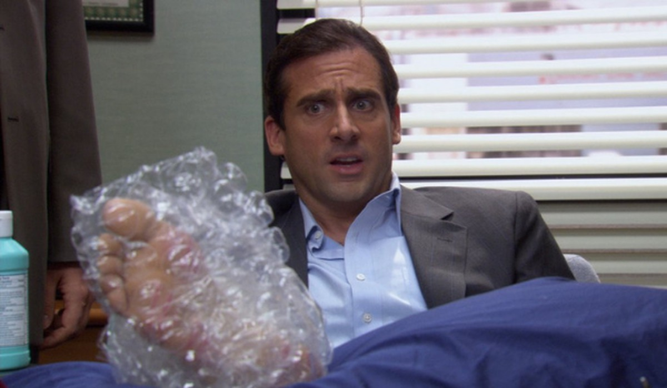
Conclusions
Top 5 episodes of ”The Office” are…
“The Injury” S2.EP12

Slide 29
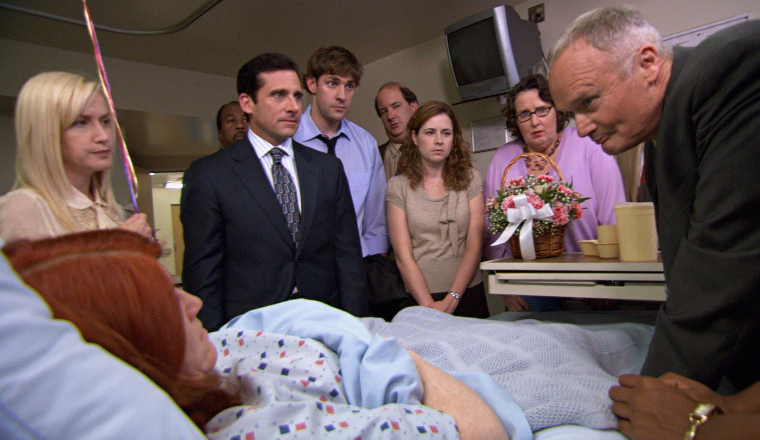
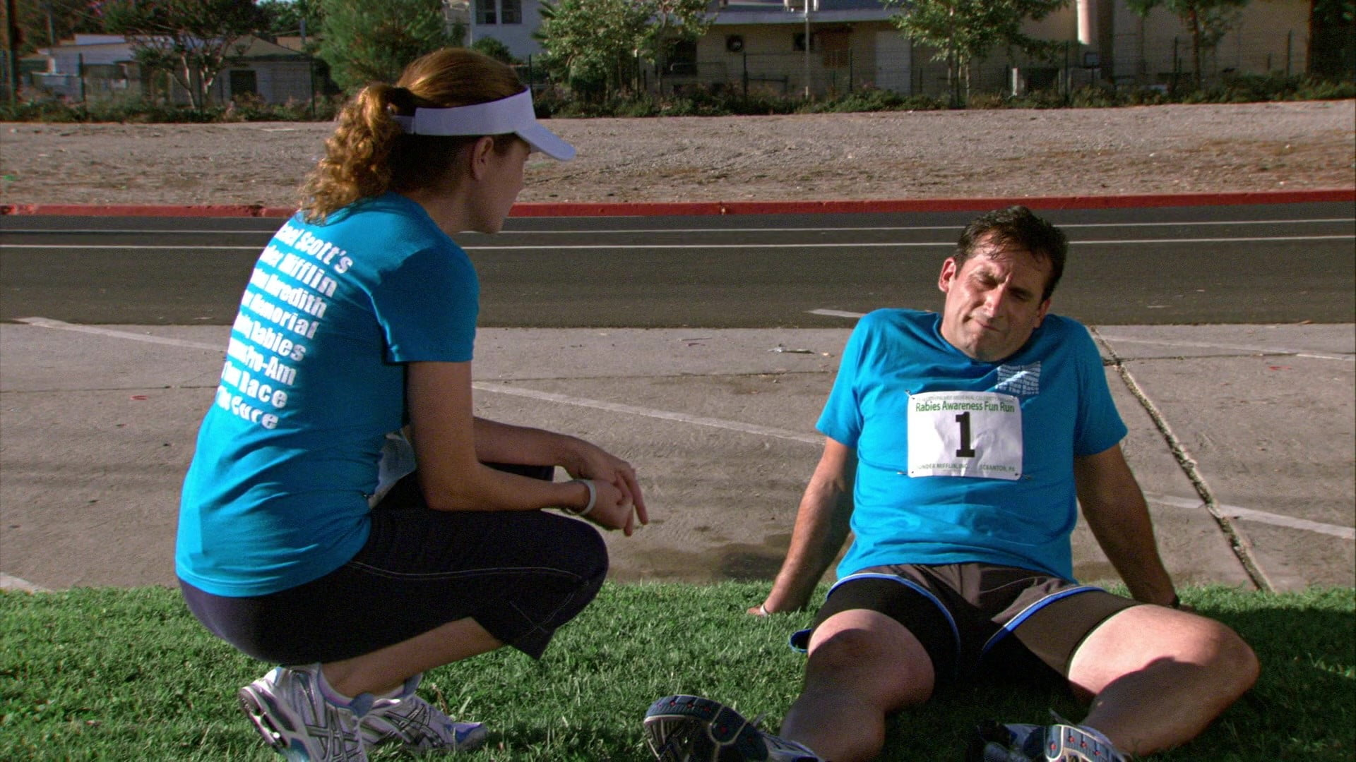
Conclusions
Conclusions
Top 5 episodes of ”The Office” are…
“Fun Run” S4.EP1

Slide 30
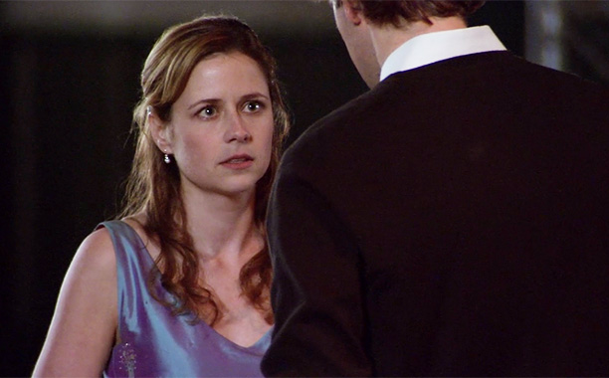
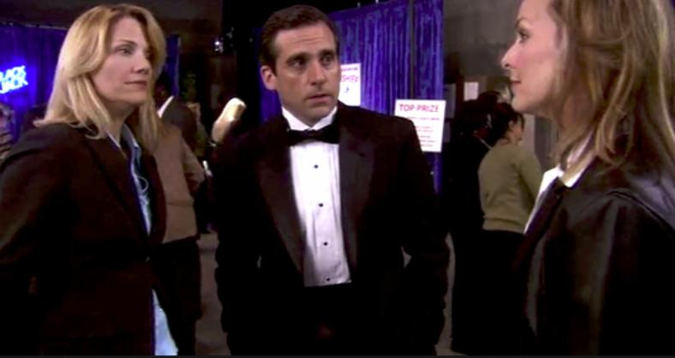
Conclusions
Top 5 episodes of ”The Office” are…
“Casino Night” S2.EP22

Slide 31

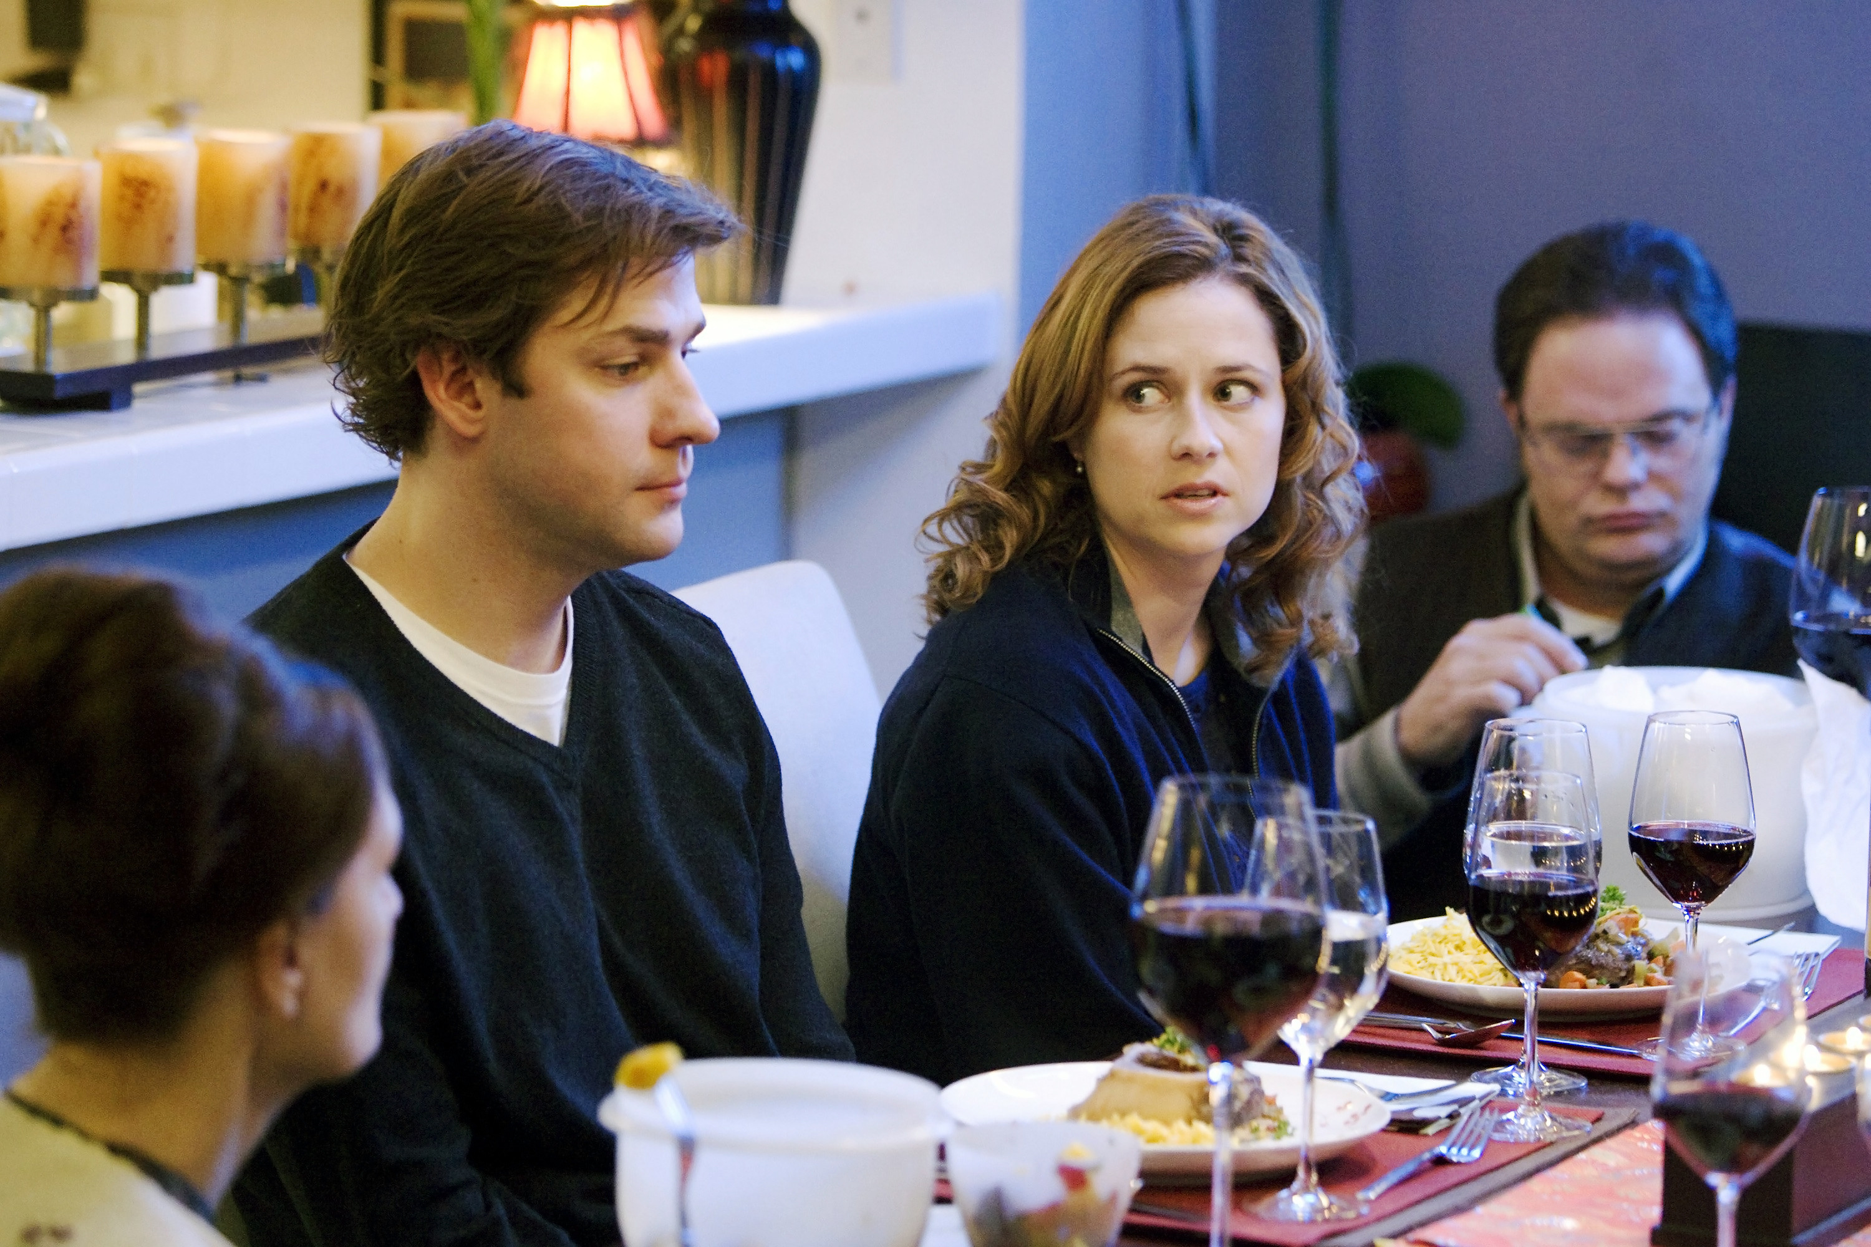
Conclusions
Top 5 episodes of ”The Office” are…
“Dinner Party” S4.EP13

Slide 32
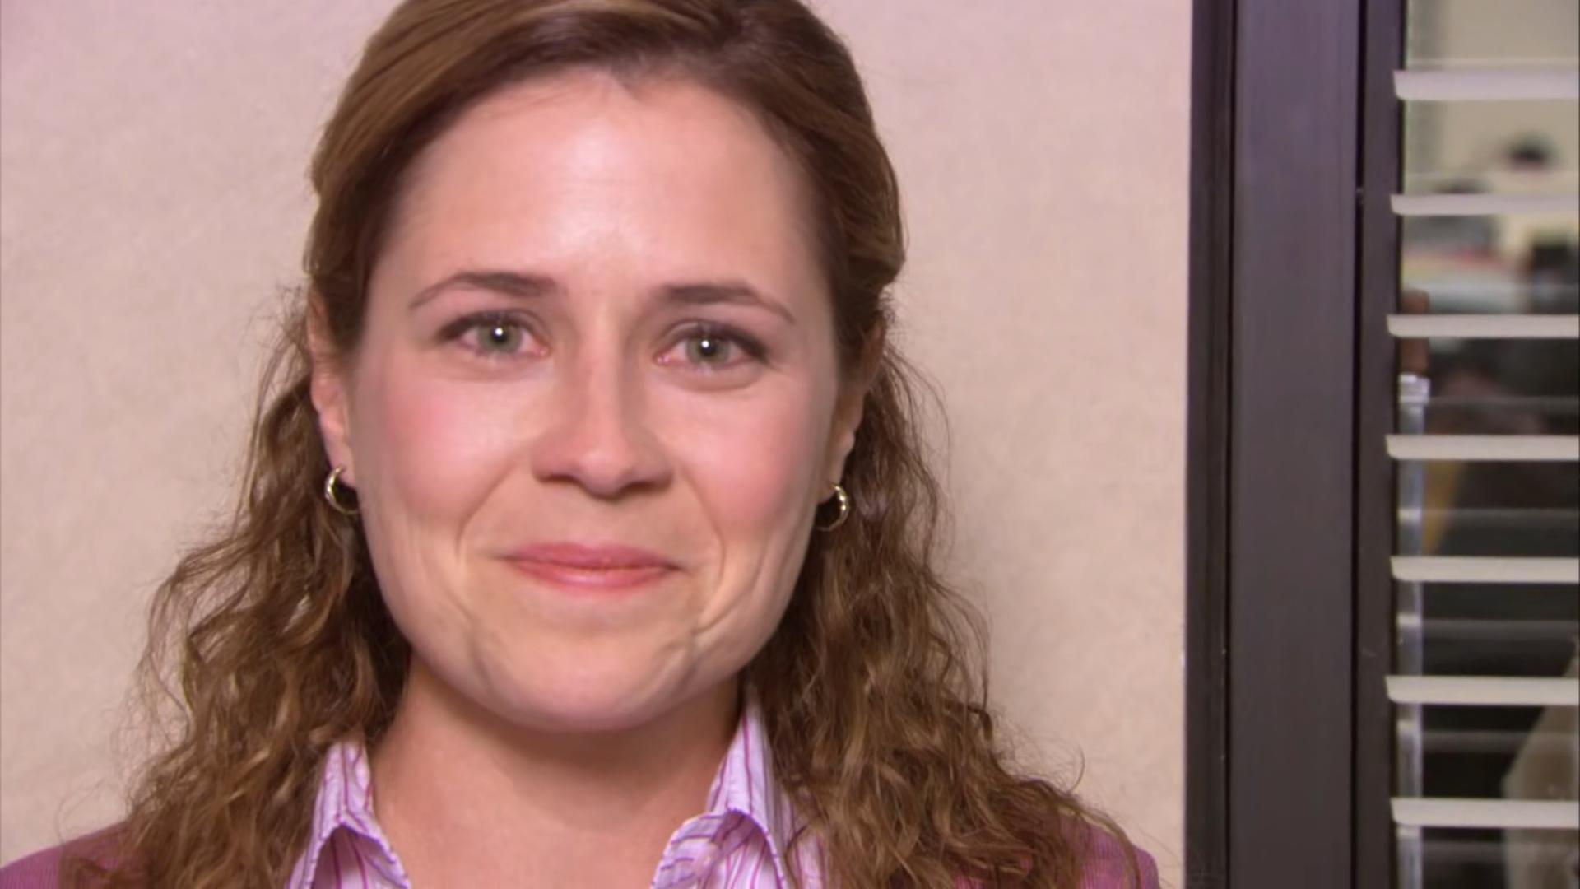
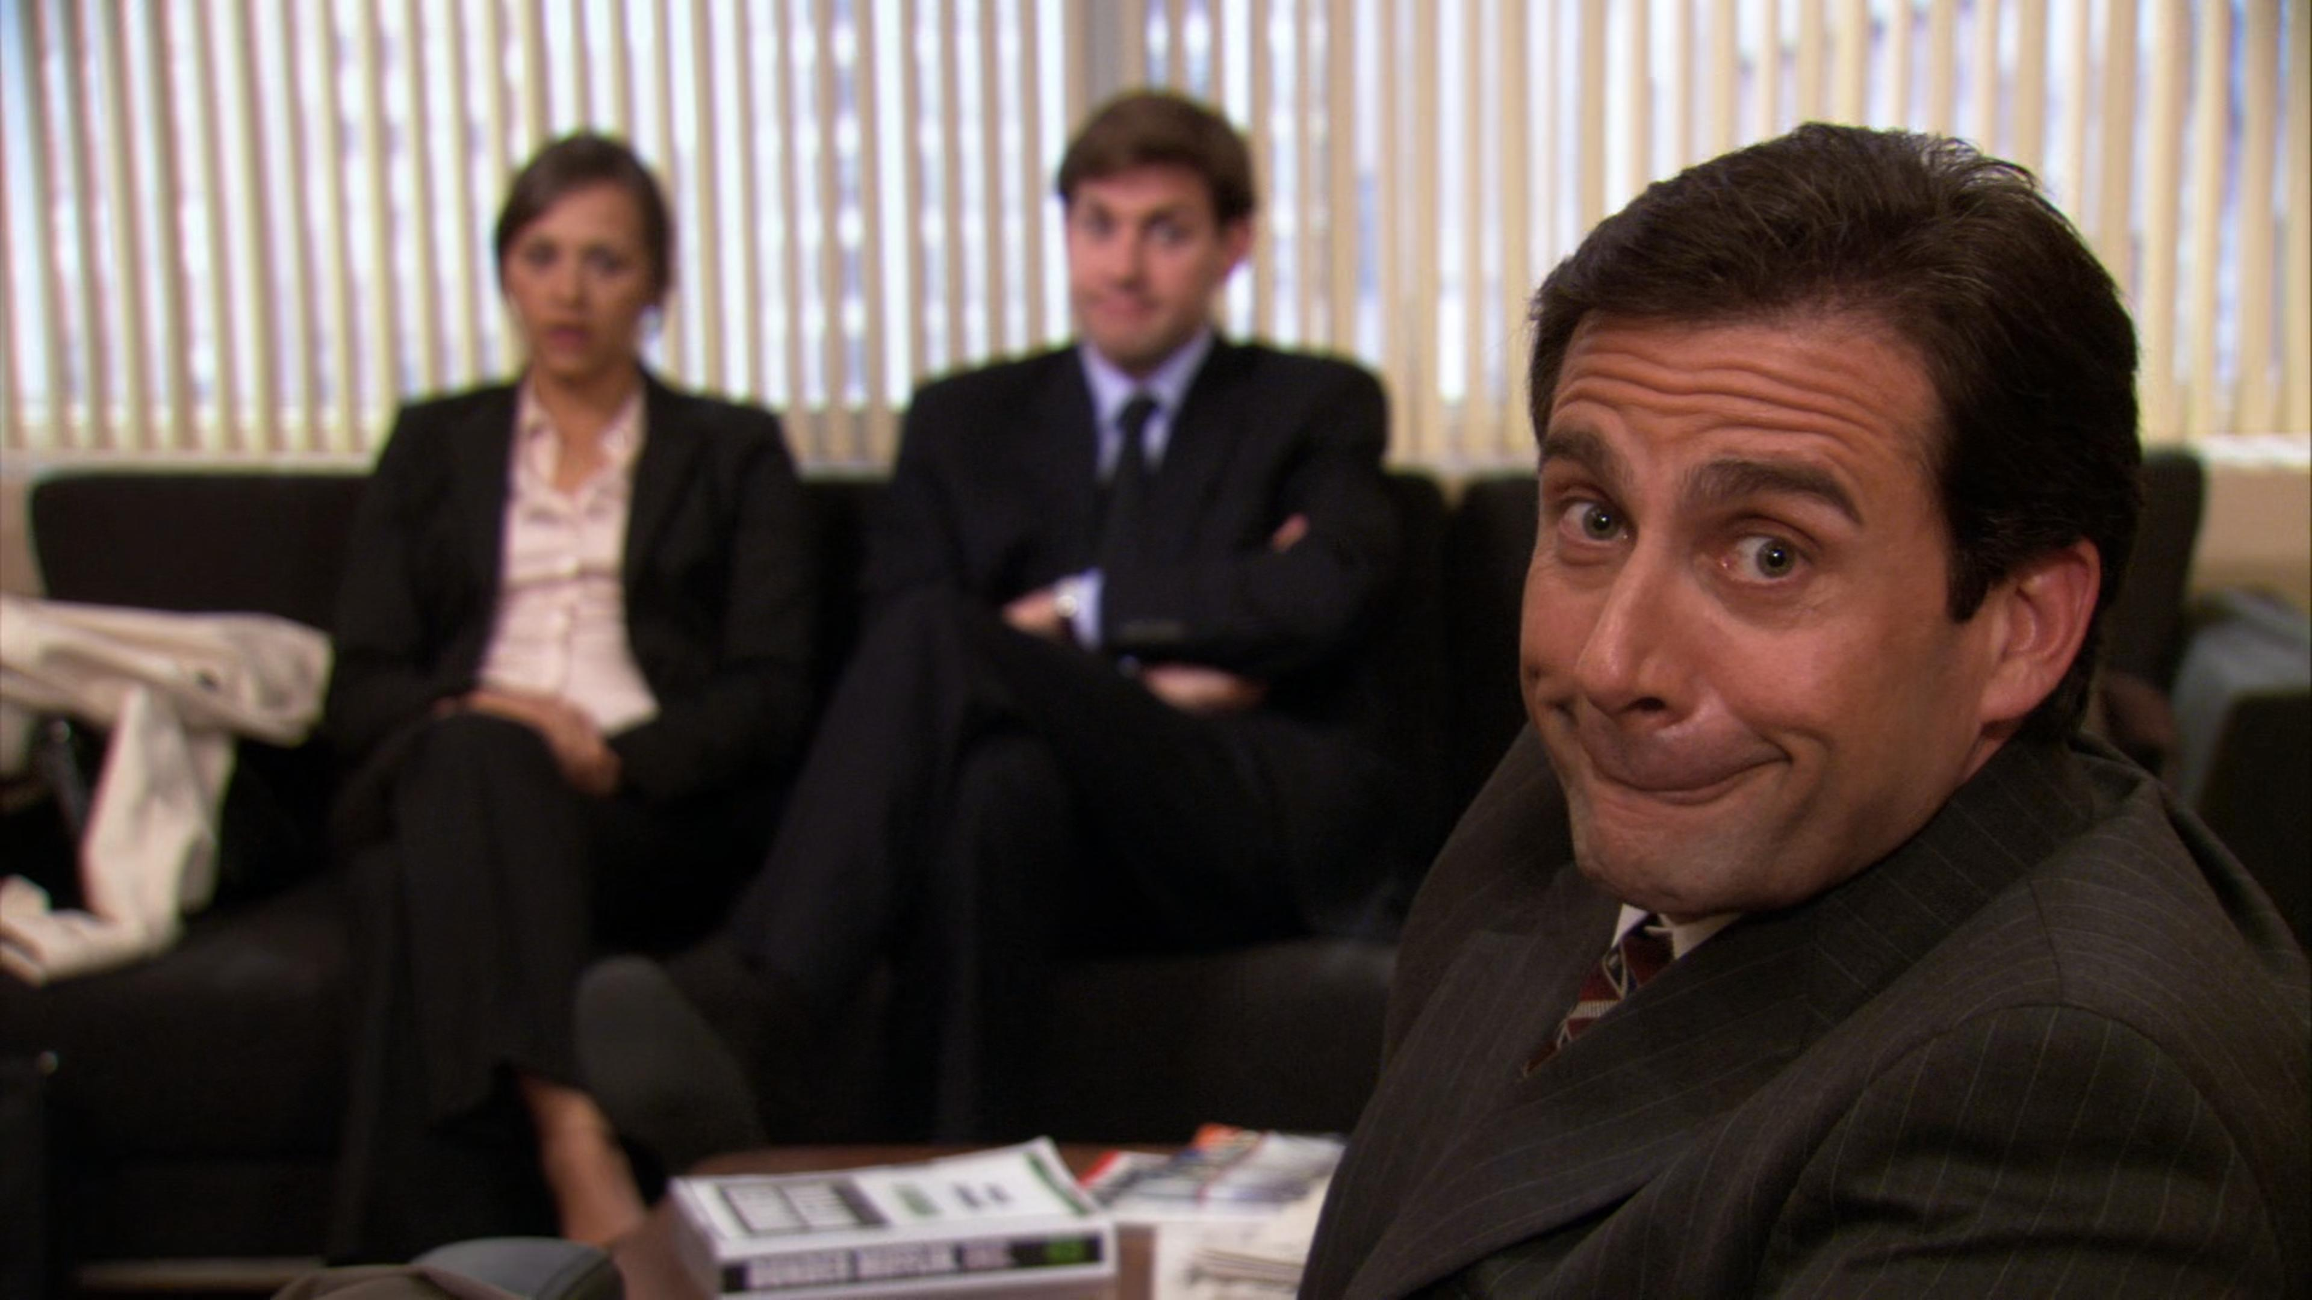
Conclusions
Top 5 episodes of ”The Office” are…
“The Job” S3.EP24

Slide 33
Conclusions
Top 5 episodes of ”The Office” are…
“The Injury” S2.EP12
“Fun Run” S4.EP1
“Casino Night” S2.EP22
“Dinner Party” S4.EP13
“The Job” S3.EP24

Slide 34
Conclusions
Top 5 episodes of ”The Office” are…
“The Injury” S2.EP12
“Fun Run” S4.EP1
“Casino Night” S2.EP22
“Dinner Party” S4.EP13
“The Job” S3.EP24
Jim, Pam, Dwight, and Michael are the main characters that contribute most to the comedy and plot line of the show

Slide 35
Thank you!!!

Slide 36
https://www.imdb.com/title/tt0664528/
https://www.imdb.com/title/tt1026035/mediaviewer/rm97498625/?ref_=tt_md_5
https://www.imdb.com/title/tt0800604/
https://www.imdb.com/title/tt1031477/

